Slide 1
Capitalism & Socialism
A Primer
Notes:
“The business of America is business.” -- Calvin Coolidge
This is the first and last time you will ever hear Calvin Coolidge’s name. He is one of those forgotten presidents. Nevertheless, his quote about business was true in 1924 and it remains true today. If there is an American culture, it is a business culture. Typically, we don’t associate “culture” with business. If you think about the “culture” of France, you might think about fine French food or wine. If you think about the culture of Russia, you might think about the opera or ballet. Some people look at America and conclude it has no culture, but that’s not true. We have a business culture. America is about finding a career, presumably doing something productive and valuable with one’s life, and about making money—and ultimately using that money to purchase material comfort (e.g., a home in a neighborhood with little to no crime, a car that is new enough not to worry about major repairs, a vacation every now and then).

Slide 2
Outline
The Basics
Capitalism
Socialism
Why economics is so important
Globalization
Health Care
Energy Policy (Fossil Fuels v. Climate Change)
A Global Perspective
Economic differences in the world
Advantages of Socialism
Advantages of Capitalism
The Disadvantages of Both Systems
Why Capitalism Has Prevailed in America

Slide 3
Capitalism: The Basics
What is Capitalism?
A simple definition: an enterprise that is privately owned, privately controlled
Individual rights: individual right to property, not community/society rights prevail in a capitalist system
The Goal: provide a product or service that people want to purchase, make money (the profit motive)
What would meet this definition?
Most businesses: Domino’s Pizza, Best Buy, Microsoft, the NFL
Capitalism and Socialism often are referred to by other names
Capitalism is often referred to as the “free market system” or as a realm reserved for the “private sector”
Socialism is sometimes referred to as “social justice” or “fair play” or even “state capitalism” (when government owns industries that trade goods and services in world markets)
Notes:
Socialism is not a word used in America today because socialists and communists were persecuted in America between 1917-1957--socialism (the word, not the idea) became discredited during this era. Socialists were considered a “clear and present danger” during WWI, WWII and the Cold War; socialists and communists were jailed from 1917 to the late 1950s. Communists were equated with the atheism of the Soviet Union.
The word “socialism” is still a dirty word in American politics. More palatable descriptions of socialism are “social justice” or “fair play.”
Patent rights are property rights...Ralph Nader (3rd Party/Green Party leader) wants to “reform” patent rights for the pharmaceutical industry such that the government would own the patents rather than the drug companies. This would be a turn toward socialism, but it won’t happen given that America has a more capitalist culture.

Slide 4
Socialism: The Basics
What is Socialism?
A simple definition: an enterprise that is government owned, government controlled
Collective Interests: community/society interest in property prevail in a socialist system, not individual rights
The Goal: Provide a product or service to the population as a whole without regard to the individual’s ability to pay (no profit motive)
What would meet this definition?
Government monopolies (or Government corporations): the Post Office, Amtrak (passenger trains), Houston Metro (local public transportation)
The public school system: Though public schools are controlled by local government, that still constitutes government control
Notes:
The Texas Constitution on education: Art. 7, Section 1 -- Support and Maintenance of school system of public free schools -- A general diffusion of knowledge being essential to the preservation of the liberties and rights of the people, it shall be the duty of the Legislature of the State to establish and make suitable provision for the support and maintenance of an efficient system of public schools.
Public schools (which are socialist institutions) are part of the Texas Constitution. Government-owned land is socialist-oriented; this would include national parks

Slide 5
Government Policies
What is a socialist-leaning policy?
Government Activism – programs designed to transfer wealth from rich to poor to achieve more equality in society
Government Subsidies – cash payments or tax breaks to encourage certain behavior, such as encouraging farmers to grow certain crops at a fixed quantity or to encourage businesses to install energy efficient light bulbs and windows
Government regulations – programs that govern how a business operates, such as fixing prices for products sold to the public or setting rules for hiring employees
What is a capitalist-leaning policy?
Free (or Freer) Trade – allows foreign produced products to compete on equal terms with American produced products in America and in other countries
Deregulation – reducing government control over business, such as allowing airlines to set ticket prices (rather than government setting prices)
Tax Cuts – gives individuals and businesses more money to invest and spend, hopefully in ways that promotes economic growth more than government would if it controlled the money
Notes:
Examples of Government Activism: 1) affirmative action (educational opportunities), Title IX (women’s athletics)), 2) welfare, 3) public roads, 4) public housing, 5) income security (Social Security, bank deposits)
Examples of Government Subsidies: 1) corporate subsidies to American companies competing overseas, 2) subsidies to farmers to grow certain crops or not to grow anything at all (in order to manipulate the forces of supply and demand), 3) subsidized health care (prescription drugs for elderly, Medicaid for the poor, health insurance for UH employees)
Examples of Government Regulations: 1) anti-discrimination laws in hiring and promoting employees, 2) price controls (on goods and services), 3) anti-trust laws (i.e., breaking up companies that become monopolies), 4) Zoning laws (by local government)
Deregulation Efforts:
Carter (1977-1981) - deregulated airlines, trucking industry, and began to phase out price controls on natural gas
Reagan (1981-1989) -- lifted price controls on oil, broke up ATT (the telephone monopoly), generally reduced regulations (e.g., oil exploration, credit cards, etc.)
Clinton (1993-2001) -- deregulated telecommunications and banking
Telecommunications deregulation has produced opportunities for companies to own radio, TV, cable stations…Clear Channel Communications own more than 1200 radio stations nationwide

Slide 6
Capitalism and Socialism
Why is economics so important?
Free Trade – “Freer” world trade is causing tension
World Trade Organization (WTO) and US are driving globalization, a move toward more capitalism
Much of the rest of the world is concerned about a US-led world economy
Domestic Economics:
Heath Care – As many as 47 million Americans have no health care coverage (some say 12 million)
America’s health care system is a combination of both socialism and capitalism
Socialism: Government pays for almost all of the costs of health care for the poor (Medicaid) and a large portion of health care costs for the elderly (Medicare)
Capitalism: Drug companies can charge what they want for prescription drugs…private insurance pays for much of the costs for those who are covered
Notes:
Domination by the US should not be as much of a concern as it is. In America, when the personal computer market was brand new, IBM was in a position to dominate the PC market. But IBM made a few bad business decisions, such as contracting its operating system to Microsoft, a tiny company at the time. And Apple, another small company at the time, made a better computer than IBM. For a time, IBM got out of the PC market because it didn’t compete well. Today, Microsoft dominates the market in software and operating systems, and IBM is just one of many PC manufacturers. The point is that in a free market, big powerful companies can make mistakes and lose their market share.
The same could happen to America. The US would start off with a huge advantage in the world market of free trade, but if US firms make bad decisions, someone else in the world will capitalize and take market share away.
Every county in Texas has a free county hospital. This too is socialist.

Slide 7
Capitalism and Socialism
Why is economics so important?
Domestic Economics (cont.)
Energy Policy (Fossil Fuels and Climate Change)
Continued capitalist policies would favor the oil industry, oil would remain the world’s dominant energy source
But burning carbon-based fuels increases greenhouse gases, so what do we do to solve “climate change”??
Socialist Option: an equivalent “Man-to-the-Moon”-like project to find an alternative energy source to oil (government-sponsored and funded)
Capitalist Option: no government intervention is necessary – auto-makers are marketing hybrid vehicles, electric motor technology will gradually replace combustion-motor technology

Slide 8
A Global Perspective

Slide 9
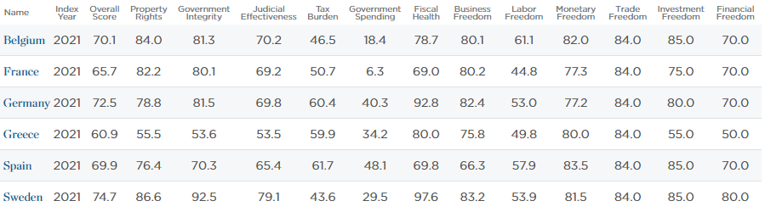
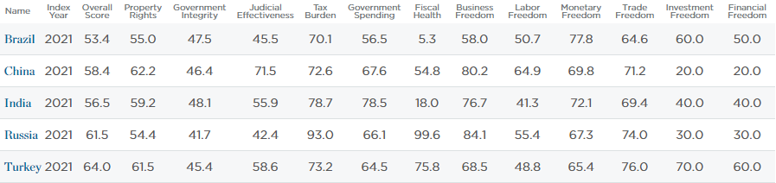
A Global Perspective Capitalism and Socialism
A Few Social Democracies in Europe
In America, we think of many of the European countries as “socialist democracies.”
Europeans pay higher taxes and spend more as a % of GDP, but when all economic indicators are considered, the European countries have majority-capitalist economies.
BRICs + Turkey – Future Economic Powers
The BRICs—Brazil, Russia, India and China—are majority-capitalist economies today.
Notes:
Source: Index of Economic Freedom (Heritage Foundation: http://www.heritage.org/Index/Ranking.aspx)
Source: Explore the Data (Heritage Foundation: https://www.heritage.org/index/explore?view=by-region-country-year&u=637555099983865866)
The index (Overall Score):
0 – 100% socialist
50 – 50% socialist/50% capitalist
100 – 100% capitalist
How to read the index: Take Belgium. It’s overall score is 70.1. That means that Belgium is ~71% capitalist and ~29% socialist. On the specific measure of the size of government (labeled “government spending”), which is a measure of bigger v. smaller government, Belgium’s score is 18.4. This score is counter-intuitive; though the score is low (below 50), a low score means that Belgium has a very large government (i.e., that government provides many services), which is the opposite one would expect (you would think a high score would indicate a bigger government, but that’s not the case on this measure). On the measure of “government spending,” Belgium would be ~82% socialist (100 – 18.0 = ~82) and 18% capitalist.
Here’s and explanation of the 12 measures of economic freedom:
https://www.heritage.org/index/pdf/2021/book/2021_IndexofEconomicFreedom_CHAPTER02.pdf
12 quantitative and qualitative factors, grouped into four broad categories, or pillars, of economic freedom:
Rule of Law (property rights, government integrity, judicial effectiveness)
Government Size (government spending, tax burden, fiscal health)
Regulatory Efficiency (business freedom, labor freedom, monetary freedom)
Open Markets (trade freedom, investment freedom, financial freedom)
Each of the twelve economic freedoms within these categories is graded on a scale of 0 to 100. A country’s overall score is derived by averaging these twelve economic freedoms, with equal weight being given to each.

Slide 10
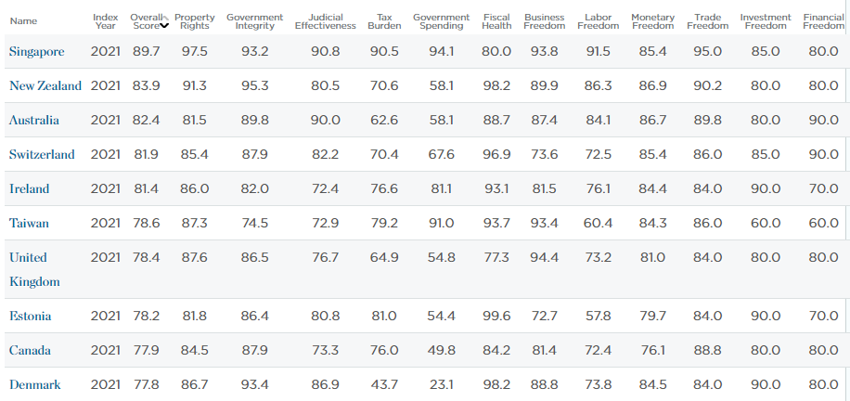
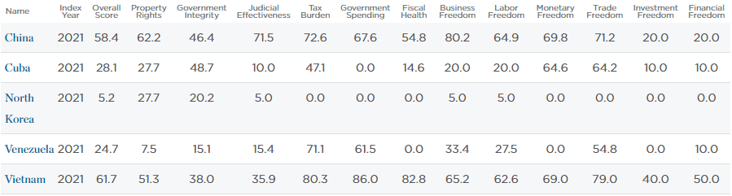
A Global Perspective Capitalism and Socialism
10 Most Capitalist Countries + U.S.
Contrary to popular belief, the US is not the most capitalist country—it ranks 20th. Singapore is authoritarian but very capitalist
The Remaining Communist Countries + Venezuela
China and Vietnam have moved from the communist model to an authoritarian capitalist model
Notes:
https://www.heritage.org/index/explore
Notice that in the communist states + Venezuela, property rights are not well protected by government (mostly <50 on the scale), meaning that you really don’t own anything. Corruption is very high, which as a retarding effect on the economy; people don’t want to engage in an economic transaction if they have to pay off a corrupt government official every time. Financial freedom is low, meaning that the government controls or regulates much of what banks do. You don’t see these problems in the most capitalist countries.
Here’s and explanation of the 12 measures of economic freedom:
https://www.heritage.org/index/pdf/2021/book/2021_IndexofEconomicFreedom_CHAPTER02.pdf
12 quantitative and qualitative factors, grouped into four broad categories, or pillars, of economic freedom:
Rule of Law (property rights, government integrity, judicial effectiveness)
Government Size (government spending, tax burden, fiscal health)
Regulatory Efficiency (business freedom, labor freedom, monetary freedom)
Open Markets (trade freedom, investment freedom, financial freedom)
Each of the twelve economic freedoms within these categories is graded on a scale of 0 to 100. A country’s overall score is derived by averaging these twelve economic freedoms, with equal weight being given to each.

Slide 11
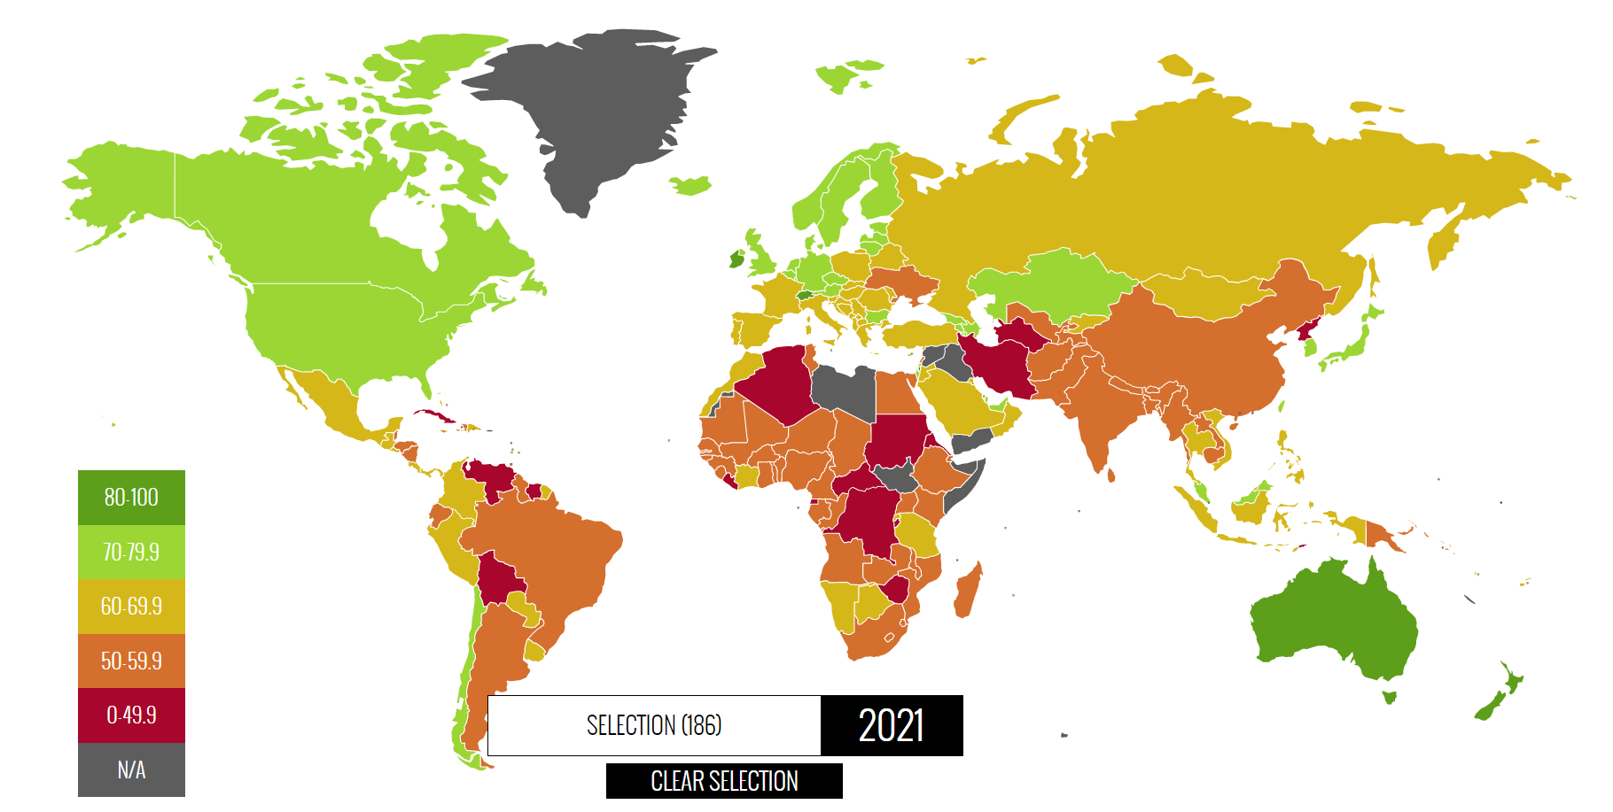
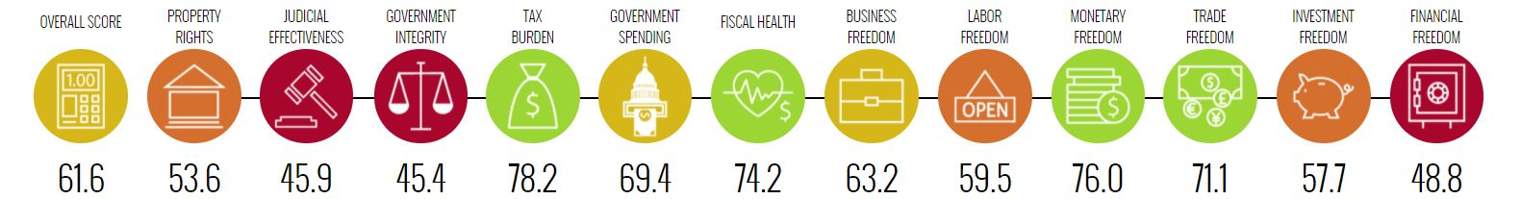
A Global Perspective Heritage Foundation Index on Economic Freedom in the World (2021)
Notes:
Source: http://www.heritage.org/index/default & http://www.heritage.org/index/heatmap
Notice that the Heritage Foundation considers the U.S. to be “mostly free”—it does not rank among the “free” countries. America has fallen to 20th on the list of most capitalist countries. Here is what Heritage has to say about the United States (2021 index): “The United States received its lowest score and lowest ranking ever in the Index, although it remains “mostly free.” The major obstacles to greater economic freedom in the United States continue to be excessive government spending, unsustainable levels of debt, and intrusive regulation of the health care and financial sectors.”
Here is further detail regarding the legend for the graphic above:
Green (80% or greater capitalism) -- "free" Light Green (70% - 79% capitalism) -- "mostly free" Mustard/Yellow (60% - 69% capitalism) -- "moderately free" Orange (50% - 59% capitalism) -- "mostly unfree" Red (< 50% capitalism) -- "repressed"

Slide 12
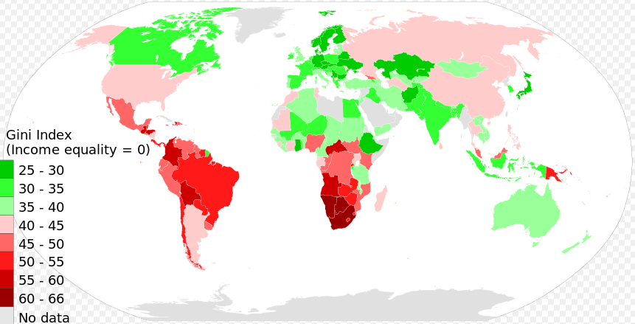
A Global Perspective The GINI Coefficient A Measure of Income/Wealth Inequality
Reducing income inequality is a socialist value (capitalism produces great disparities in income and wealth). Scandinavian countries (Norway, Sweden, Denmark, Finland) have the greatest equality in the distribution of income and wealth. Wealthier countries tend to produce more equality in income and wealth (the US is an exception).
Notes:
Source: http://en.wikipedia.org/wiki/Gini_index (Updated: 2014)
The lower the GINI coefficient, the greater the equality of wealth and income distribution across the society. The higher the GINI coefficient, the greater the inequality of wealth and income distribution across society. Reducing income inequality is a socialist value. In a capitalist system, there will be larger disparities between rich and poor, and a capitalist would argue that inequality is what provides the impetus for people to improve their financial position and “lot in life.”
The GINI coefficient does not measure total wealth in a country. For instance, Ethiopia is not a wealthy country, but wealth and income is distributed more equally in Ethiopia than in the US. Here is what wikipedia has to say in 2008: “Poor countries (those with low per-capita GDP) generally have higher Gini indices, spread between 40 and 65, with extremes at 25 and 71, while rich countries generally have lower Gini indices (under 40). The lowest Gini coefficients (under 30) can be found in continental Europe. Overall, there is a clear negative correlation between Gini coefficient and GDP per capita; although the U.S.A, Hong Kong and Singapore are all rich and have high Gini coefficients.”
US income Gini indices over time
Gini indices for the United States at various times, according to the US Census Bureau:^{[13][14][15]}
1929: 45.0 (estimated)
1947: 37.6 (estimated)
1967: 39.7 (first year reported)
1968: 38.6 (lowest index reported)
1970: 39.4
1980: 40.3
1990: 42.8
2000: 46.2
2005: 46.9
2006: 47.0
2007: 46.3
2008: 46.69
2009: 46.8
2010: 46.9
2011: 47.7 (highest index reported)

Slide 13
A Global Perspective Two-Dimensional Ideology
Horizontal Axis – Civil liberties v. Police Power (Freedom House Scale)
Vertical Axis – Capitalism v. Socialism (Heritage Foundation Index)
Capitalism
The most successful countries in terms of wealth and freedom are found inside the oval.
Singapore
Canada
USA
GB
Netherlands
Japan
Mexico & Peru
Saudi Arabia
France
Israel
Economics
Panama
Lebanon
Jordan
Nigeria
Argentina
India
Russia
China
(Today)
Ukraine
Bolivia & Ecuador
Iran
Venezuela
China
(1980)
Zimbabwe
Socialism
North Korea
Police Power/ Civil Liberties
Civil Liberty
Public Safety
Notes:
Sources: http://www.heritage.org/Index/Explore.aspx?view=by-region-country-year (Heritage Foundation) & http://freedomhouse.org/template.cfm?page=363&year=2009 (Freedom House) Sources: http://www.heritage.org/Index/Explore.aspx?view=by-region-country-year (Heritage Foundation) & http://freedomhouse.org/template.cfm?page=363&year=2009 (Freedom House)
The Heritage Foundation also has an economic freedom index (see www.heritage.org). Heritage measures “economic freedom” by the following criteria: 1) Business freedom, 2) Trade freedom, 3) Fiscal freedom, 4) Freedom from government, 5) Monetary freedom, 6) Investment freedom, 7) Financial freedom, 8) Property rights, 9) Freedom from Corruption (Transparency Index), and 10) Labor freedom. The top 5 rankings are: 1) Hong Kong, 2) Singapore, 3) Australia, 4) New Zealand, 5) Ireland (the US is 8th).
Here are the Heritage Foundation’s ranking for each country shown on the chart (2010): Singapore (86.1), Canada (80.4), USA (78.0), Great Britain (76.5), Japan (72.9), Mexico (68.3), France (64.2), China (51.0), Russia (50.3), Iran (43.4), Venezuela (37.1), Zimbabwe (21.4), North Korea (1.0).
Freedom House measures civil liberties by the following criteria: 1) Civilian control of the police, 2) freedom from police terror, 3) unjustified imprisonment, exile, torture, 4) Absence of economic exploitation (i.e., sweatshops), 5) Corruption of government, military, or organized crime in business, 6) Right to own private property and businesses. The ranking ranges from 1 to 7 – 1 meaning there are a great deal of civil liberties (or freedoms) and 7 meaning there are no civil liberties (or no freedoms).

Slide 14
Advantages v. Disadvantages
Socialism v. Capitalism

Slide 15
Advantage of Socialism
Time and Resources
Through socialism, the government can marshal the country’s resources (money through taxation) to accomplish a goal more quickly than the private sector
The Intercontinental Railroads (1860s) – the government helped (through land grant subsidies) the railroad companies connect the Eastern US with the West by rail in 4 years (1865-1869)
It took a privately-funded railroad company 20 years to build an intercontinental railroad (the Great Northern Railroad: 1869 - 1889)
The Moon Project – the government put a man on the moon in less than 10 years
Exxon/Mobile (a wealthy oil company) has the resources to fund a man-to-the-moon project but hasn’t done so, there is no obvious profit motive
The Internet – the military created the internet beginning in the late 1960s
The private sector did not initially create the internet
Notes:
There is always a problem with quality when it comes to socialism. The government-subsidized railroads were of very poor quality and there was an enormous amount of corruption associated with these projects. The Great Northern railroad had no such quality or corruptions problems.
Also, the internet was cryptic and very difficult to use when it was controlled by government. But once the private sector took over, the internet has become a new industry (easy to use and it accounts for about 10% of the US economy).

Slide 16
Advantage of Socialism
Socialism has a psychological advantage
Socialism eases our fears of the unknown
Socialism is psychologically comforting, particularly on matters of basic necessities (health & career opportunities)
In a socialist health care system, a patient knows that he/she will see a doctor, will get some degree of treatment...that’s a guarantee, even when the patient can’t afford to pay
Capitalism is frightening, the future is unknown
When the future is unknown, people tend to fear the worst (i.e., become risk averse)
The psychological factor (fear) is in play, driving support away from capitalism toward the comfort of socialism
Will people be able to afford health care in a capitalist system? Maybe….but then again, maybe not…the future is unknown
Notes:
Socialist polices include universal access to health care, job security, and unemployment in case one loses a job. These are sometimes called safety net programs. Why do people leave their home countries to come to America? In most cases, it is to earn a better living so that one can live a more comfortable life. Why do we form legal contracts? Both contracting parties want to be “comfortable” about not getting ripped off. If one party breaches the contract, the other party (the plaintiff) can take the first (the defendant) to court, and if the plaintiff wins, then he or she will be compensated. The real and psychological appeal of comfort is very powerful; we tend to underestimate how important psychological comfort is.

Slide 17
Advantage of Socialism
Socialism promises equality
The promise of equality makes socialism very appealing
Equality is difficult to achieve, e.g., in Europe and Canada, the wealthy have access to better health care
In the former Soviet Union, those with connections had access to higher quality goods and services
Capitalism produces great inequalities in:
income, wealth, living conditions, and general quality of life (e.g., rich can afford better education & health care)
Supporters of capitalism accept inequality in income and wealth as a mechanism that drives the system
It is that chance to become rich, to do something extraordinary, that makes capitalism work
Conclusion: 1) accomplishing a goal in shorter time, being able to marshal more resources, 2) appealing to the psychology of comfort, and 3) advocating the principle of equality gives socialism an advantage
Notes:
The European countries and Canada have socialized health care systems, i.e., health care is provided by government at no direct charge to those who use the system. (Indirectly, taxes pay for the health care system). Still, there are two health care systems in all of these countries. Rich people can afford better health care.
The Soviet Union was a communist country. In theory, all the resources of society were controlled by government and were supposed to be distributed equitably to all. But it didn’t really work that way in practice.
After the Soviet Union fell, socialist-advocates looked to Sweden as a model. In the 1990s, Sweden took a turn toward lower taxes to create a more business friendly climate (these are capitalist-oriented policies). All countries have a dark side and Sweden is no exception. In the 1940s, Sweden engaged in genetic engineering, a sterilization program of those at the bottom of the socio-economic ladder.

Slide 18
Advantage of Capitalism
Capitalism's advantages
Technology: No accident that America is responsible for much of the advances in technology: in computers, the internet, oil exploration and drilling, medical science, etc.
Are Americans just smarter?
No. Much of the brain power in America is imported from other countries (i.e., immigrants)
America has a high degree of economic freedom (i.e., capitalism) and a strong business-oriented culture
“Magic in the Marketplace”: It takes time, but capitalism eventually makes products and services affordable, even for the poor
The VCR – In 1975, a VCR cost approximately $2000 (in today’s dollars)...in 2009, a VCR cost $60 and its quality was far superior
Technology has improved so much that it would be very difficult to even find a VCR today
The Computer – A computer today has more computing power, faster operating speeds, better graphics...all for less money, prices have dropped precipitously in the last 20 years
Notes:
Technological advances in medical science is a mixed bag...much research is government funded through the NIH...this type of research is semi-socialist...one might argue that capitalism has failed in the realm of medical sciences, but we don’t have a high degree of capitalism in this field
Sweden is responsible for some advances in cell phone technology.

Slide 19
Advantage of Capitalism
Capitalism's advantages
“Magic in the Marketplace”:
The Internet: the US government created the internet, so that the military leaders could communicate with troops in a time of war
In 1992, the internet was opened to individuals and businesses
Now, the general public can use the internet for communications, purchasing products, buying stocks and even for starting businesses (e.g., on Ebay)
Greater Opportunities for Entrepreneurship: It doesn’t always happen, but extraordinarily talented people, even those who have no family or wealth connections, can succeed in the marketplace
Thomas Edison -- inventor of light bulb, phonograph, motion pictures, and about 1000 other inventions...created electric power industry (1880s)
Edison was not formally educated, did not have a prominent family name, did not come from wealth...yet succeeded
Notes:
The internet was created by the U.S. government, specifically by the military in the 1960s and 1970s. The military monopolized the internet in the interest of national security. At the time, the U.S. was in a “Cold War” with the Soviet Union, and the military believed that an electronic network (i.e., the internet) would survive a nuclear blast, should the Soviets launch a nuclear strike, and that the generals could use the internet to communicate with troops in the field under that scenario (of a nuclear attack on the U.S.). In December 1991, the Soviet Union collapsed, breaking into its 15 component countries, and the Cold War was over. Six (6) months later, in 1992, Congress released the internet to private businesses and individuals because the national security threat which had justified the military’s monopoly over the internet had disappeared.
Had the Soviet Union collapsed in 1981, ten years earlier in this hypothetical, then the internet would have been released to the public in the 1980s. Had the Soviet Union collapsed in 2001, ten years later in this hypothetical, then it would have been released in the early 2000s. The release of the internet coincided with the end of the Cold War, when the national security threat the Soviets posed ended.

Slide 20
Advantage of Capitalism
Capitalism's advantages
Greater Opportunities for Entrepreneurship:
Wright Brothers -- invented the airplane in 1903
The Wrights were not formally educated, did not have a prominent family name, did not come from wealth...yet succeeded
Michael Dell -- founder of Dell Computers in 1985
Dell was a college dropout, did not have a prominent family name, did not come from great wealth...yet succeeded
Flexibility – Capitalism reacts more quickly to demands for change than socialism
In a capitalist system, some economists claim that only 5% to 7% of customers are required to force change in a product or service
Businesses fear “the slippery slope,” fear losing their customers
In a democratic socialist system, a sustained majority (50%+) would be required for change
Notes:
Who are some of the more recent entrepreneurs succeeding in America? Elon Musk (PayPal, Tesla Motors, SpaceX), Mark Zuckerberg (Facebook), Jack Dorsey (Twitter), and the list goes on and on. In every era of American history, you can find great entrepreneurs.
Why doesn’t the Congo or Iran produce people like Thomas Edison, the Wright Brothers, and Michael Dell? First and foremost, a country must have security. Despite the terrorist threat and a large criminal element in America, we still have a high-degree of security in the United States. America’s scientists and engineers certainly don’t feel threatened when they go to work every day. In some other countries, like the Congo and Iran, people just want to do what they have to do to survive. When your mind is focused on survival, you won’t be inventing the next generation of communication devices. Secondly, a country needs a high degree of wealth. Once most people have enough money in their bank accounts to cover the basic necessities of life—food, shelter, clothing, transportation, education and health care—then they can start to focus on more “luxurious” pursuits, like the arts and sciences. If you give Iran and the Congo the type of wealth and security as that which exists in America, as well as a super-majority capitalist economy (70% + capitalism), then those countries would also produce people like Thomas Edison, the Wright Brothers, and Michael Dell.

Slide 21
Advantage of Capitalism
Capitalism’s Advantages
Conclusion: 1) capitalism produces more technological advance, 2) higher quality at lower prices, 3) more opportunities for the gifted and talented, 4) quicker responses to needed change, and 5) generally produces more wealth than socialism

Slide 22
The Disadvantages Capitalism and Socialism
The Disadvantage of Capitalism
Economic “Bubbles”: Bubbles will periodically occur in a capitalist system
Example – The US Housing Market Bubble
Speculation in the US Housing Market
High growth rates attract speculation (driven by the desire to make money quickly)
Housing prices grew at 10% per year prior to the collapse of the housing market
Those holding the investment when the “bubble” bursts lose their money
Speculation leads to fraud
Wall Street investment firms packaged risky home mortgages as investments
Rating agencies rated these investments as “safe”
Given that there was no transparency associated with these investments, investors did not know what they were purchasing
Notes:
In a capitalist system, the government must punish fraud when it occurs. As of 2013, I’m aware of only one company that has been prosecuted for “questionable” mortgage lending leading up to the financial crises and housing market collapse, and that company is JP Morgan Chase. The tentative settlement (out of court) deal is for $13 billion (as of October 2013), which would be a record penalty. The government is very slow by nature, but given enough time, I suppose some companies will be punished in the end.
Also, the Government Supported Enterprises (GSE) Fannie Mae and Freddie Mac were required by government to purchase 52% of home mortgages in America. Banks would sell their home loans to Fannie Mae and Freddie Mac, giving them little incentive to care about whether the home-buyer could afford the home (or not). As a consequence, people who could not really afford a home were encouraged to buy them, and too many of these home-buyers defaulted on their loans, causing the home mortgage collapse. The government has to take some responsibility for its role in causing the great recession by distorting the market, encouraging people to purchase homes who could not ultimately afford them.

Slide 23
The Disadvantages Capitalism and Socialism
The Disadvantage of Socialism
No Wealth Creation: Socialism does not create wealth—rather it siphons wealth from the private sector through taxation
The consequence of too much socialism
Debt: The result of too much redistribution of wealth for the purpose of providing government benefits is the accumulation of too much debt, such as health care and retirement pensions
Debt can cause insolvency if a country cannot pay its debt—then the people who are promised benefits lose those benefits
Cultural Laziness: The result of too many people receiving a benefit they have not worked to earn is laziness.
There is less incentive to be innovative and creative
What is the tipping point (too much socialism)?
According to the Heritage Foundation measure, the tipping point is approximately 30% or more socialism (70% or less capitalism)
Notes:
Can a country have too much socialism? Clearly, the answer is yes. North Korea is a good example. With the exception of a few economic zone, typically joint-partnerships with South Korea, North Korea is totalitarian and almost 100% socialist. The country experiences periodic famines and mass poverty. NK does not have sufficient wealth to keep the lights on at night. The country sits in the dark when the sun sets. When a country’s economy becomes more than 30% socialist, the capitalist side of the economy cannot generate enough wealth, which is taxed to pay for the socialist side of the economy. This results in massive debt. Plus, the culture becomes excessively lazy, and it takes decades to change a culture.
Can a country have too much capitalism? Probably. There would be no anti-discrimination laws in a purely capitalist economy. If a business owner did not want to serve blacks or gays or other “undesirables,” then that business owner could turn those patrons away, legally. The only way to punish that business owner would be to boycott the business and protest out in the streets against the discriminatory practice.

Slide 24
Why does Capitalism prevail?
Socialism has more intellectual support
US politicians often argue that it is unfair and wrong for people to be denied health care coverage because they can’t afford it
Which is an intellectual argument for socialism
But you would never hear a US politician argue that inequalities in income and wealth are a good thing.
Which would be an intellectual argument for capitalism
In America, capitalism prevails because:
Capitalism has produced a comfortable level of wealth for so many people
Public opinion tends to reflect greater support for capitalism
Also, the wealthiest buy influence in politics
The wealthy business class is America’s aristocracy, and the business class has an interest in maintaining a system that produces so much wealth
Notes:
Here are a couple of examples illustrating a lack of intellectual support for capitalism:
In 2004, the debate over outsourcing jobs to India (free trade) is a perfect example of the lack of intellectual support for capitalism. The free flow of labor from one country where labor costs are high (e.g., America) to a country where labor costs are low (e.g., India) is the free market working as it should, and in theory, it will create more wealth in both countries. But a politician would be hard pressed to argue that shutting down manufacturing plants or service centers (e.g., 24 hour call centers to assist people with computer, software or internet issues) in America, where jobs will be lost, is a good thing. In 2004, virtually no Republicans made the case for free trade, or in this case, the free flow of labor across borders. Democrats and a few Republicans blasted away against outsourcing, but it did not turn out to be a deciding issue in the 2004 presidential election.
The free trade fight over CAFTA was a turning point in America (against free trade). The Central American Free Trade Agreement (CAFTA) passed Congress in 2005, after being held up for two years, but it didn’t pass without logrolling and earmarks as enticements to encourage members to vote for CAFTA who might not have otherwise. In other words, the deciding margin of votes were not the result of a fundamental support for free trade, but instead members of Congress were bought off with promises of more money being spent their home districts.
In 2006, the debate over port security was another example where the free trade argument was not made. Security interests trumped. But capitalists argue that free trade and security are one in the same. In theory, if the UAE (United Arab Emirates) has links to terrorism, one way to move them away from continuing to support terrorism is through business ties, which places emphasis on making money and pursuing a comfortable life rather than joining causes like a Jihad against America.
In 2008, the US-Columbia free trade agreement was killed in Congress. This was more evidence that America was moving away from free trade.
In 2011, President Obama put the free trade issue back on the agenda. It wasn’t a high priority for Obama, which is why he did not push trade in 2009 and 2010, but a sluggish economy influenced the president, and in 2011, he pushed Congress to pass bilateral free trade agreements with Panama, Colombia, and South Korea. As of 2015, the president is negotiating the Trans-Pacific Partnership and the Trans-Atlantic Free Trade Agreement—these would be significant regional trade agreements.
We (Americans) go back and forth on free trade. In the 1990s, free trade was a done deal—everyone, Democrats and Republicans, were free traders, but that changed in the mid-2000s, but now in this decade, free trade is back on the agenda.

Slide 25
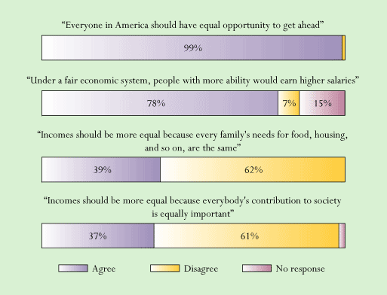
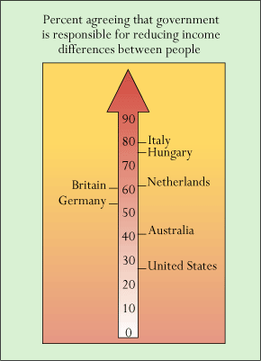
Why Capitalism Prevails in America Polls from late 1980s, early 1990s
30 years ago, support among the American people for socialism ranged from about 15% to 40%. Most people accepted capitalist values as best.
Notes:
Figure on left is Fig. 2.1 in Thomas Dye book, polls taken in 1984 (first 2 questions) and 1986 (second 2 questions)…world opinions come from US News and World Report poll, 1989
Notice that a system that would equalize income for everybody in society (socialism) receives less than 40% support. Also, America is much more capitalist oriented than the European countries (see graphic on right).
Rasmussen conducted a more recent poll on April 09, 2009
Only 53% of American adults believe capitalism is better than socialism; 20% disagree and say socialism is better. Twenty-seven percent (27%) are not sure which is better.
Adults under 30 are essentially evenly divided: 37% prefer capitalism, 33% socialism, and 30% are undecided.
Thirty-somethings are a bit more supportive of the free-enterprise approach with 49% for capitalism and 26% for socialism.
Adults over 40 strongly favor capitalism, and just 13% of those older Americans believe socialism is better.
Investors by a 5-to-1 margin choose capitalism. As for those who do not invest, 40% say capitalism is better while 25% prefer socialism.
There is a partisan gap as well. Republicans - by an 11-to-1 margin - favor capitalism.
Democrats are much more closely divided: Just 39% say capitalism is better while 30% prefer socialism.
As for those not affiliated with either major political party, 48% say capitalism is best, and 21% opt for socialism.

Slide 26
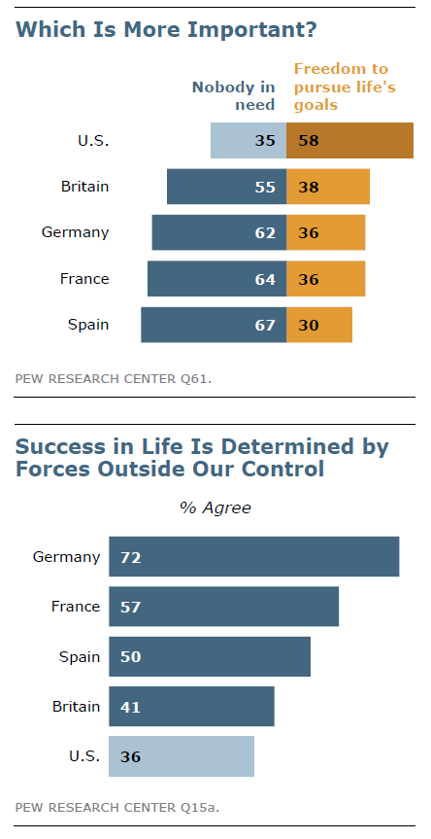
Differences in Attitudes European s v. Americans
“Nobody in need” implies support for redistributive programs to help the poor and needy
Europeans embrace redistribution of wealth (socialist-leaning policies) much more so than Americans
Americans perceive to have more freedom than Europeans, including in the business world, and thus feel more empowered to achieve success through their own efforts
Notes:
Source: Pew Research Center Global Attitudes Project – The American-Western European Values Gap– November 17 2011

Slide 27
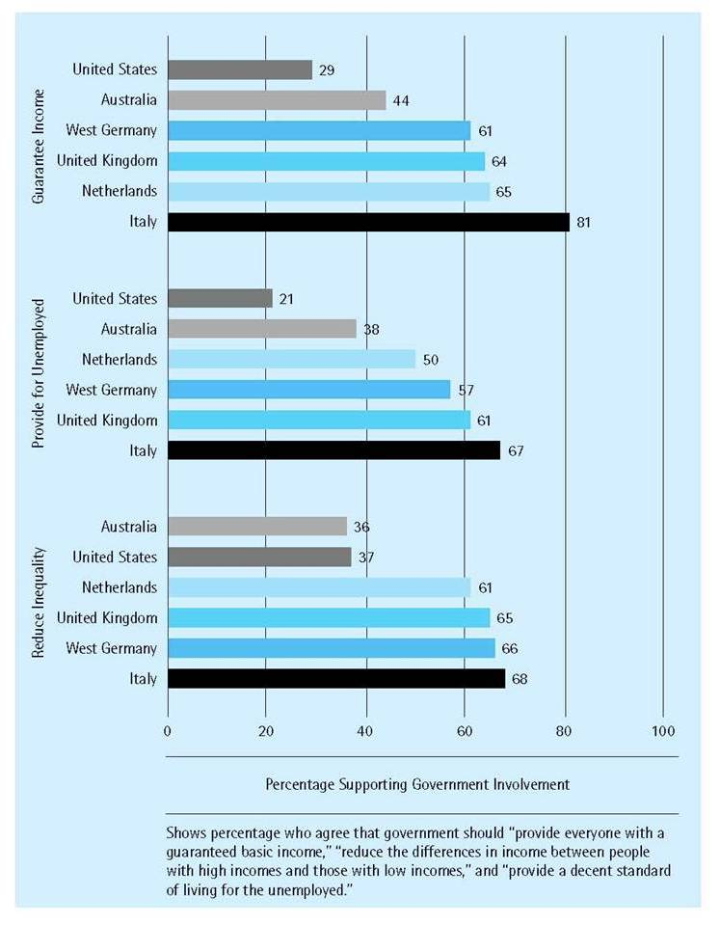
Differences in Economic Attitudes
Americans tend to hold more capitalist-leaning attitudes
Europeans tend to hold more socialist-leaning attitudes
Notes:
Source: The American Ideology (by Everett Carll Ladd): 1994. This poll was taken before 1990, when East and West Germany were reunited into one Germany.
The idea of socialism is alive in America, though it does not thrive here as it does in Europe, Scandinavia, and other parts of the world. History has a lot to do with that. We had a revolution; we adopted the principles of freedom (or anti-authoritarianism) in a very short period of time. Whereas, in Europe, the Europeans transitioned slowly from authoritarian Monarchy to free principles. Socialism is “soft” authoritarianism compared to an “iron fist” monarchy, and the transition from “hard” authoritarianism to “soft” authoritarianism has been a natural transition. In America, authoritarianism of any kind is met with more resistance. (Of course, slavery was a case of “hard” authoritarianism in America. The transition to freedom for blacks was slow in America, even though we fought a Civil War to change that.)

Slide 28

Is America Becoming Socialist (like Europe)?
During the economic crisis of 2008, US leaders (Republicans under President Bush and Democrats under President Obama) have had no faith in our majority-capitalist system to repair the problems with banking, credit, and housing
Instead, large-scale government intervention has been the preferred means of addressing the crisis
And more government oversight of the financial, credit, and housing sectors of the economy will exist after this crisis passes
Notes:
The capitalist solution to the banking and credit crisis would have been to allow the largest banking and investment firms to collapse. That would have likely caused a more severe recession, but those who brought down the American and world economy would have lost everything. And in the long run, smaller and medium sized companies would have built a more cautious banking and credit system on the ashes of the old. Instead, our leaders opted for a socialist-oriented solution to the crisis. Neither the Bush nor Obama administration believed that the private sector could solve this crisis. The government can marshal more resources and centralized authority to address the problems of banking, credit and housing.
Both elements of socialism and capitalism can be blamed for the financial crisis of 2008. The crisis began late 2007 when it became apparent that an unusually high number of “sub-prime” home loans were in default. Poor people and those with bad credit (i.e., people who have trouble paying off their credit cards and other bills) are the profile for those who would qualify for a “sub-prime” home loan. Usually, these buyers have to pay a higher loan interest rate because they are a higher risk than wealthier people and those who have good credit.
The entire world invested in the American sub-prime home loan market. That’s why so many other countries, not just America, suffered a financial crisis also. What happened is this. A bank provides a home mortgage loan to a poorer person. 50% of these sub-prime loans were then purchased by Fannie Mae and Freddie Mac, two home mortgage lenders who had a special relationship with the government (they were called Government-Sponsored Enterprises) (Wall Street investment firms purchased the other 50% of these sub-prime loans and packaged them similarly to Fannie Mae and Freddie Mac). Fannie Mae and Freddie Mac, as well as Wall Street investment firms, would then package as many as 3000 home loans into one “security instrument” and sell it (and others just like it) to an investment firm, a bank, or an insurance company here in America or overseas, wherever there were buyers. As long as the home owners paid their monthly mortgage bills, then everybody won (even the homebuyer because they own the house and have something of value), but when home owners could not pay their monthly mortgage, then whoever held the mortgage did not get paid and was out a lot of money.
On the socialist side of the equation, the government required Fannie Mae and Freddie Mac to purchase increasing amounts of sub-prime loans (42% of sub-prime loans were to be purchased by Fannie or Freddie in 1996; 50% in 2000; 52% in 2005), which in turn encouraged banks to make these risky loans to poor people and those with bad credit because the banks could immediately turn around and sell the loans to Fannie Mae and Freddie Mac, thus getting their money back and cashing in on the fees associated with closing a home purchase. Our political leaders wanted to expand the American Dream of home ownership to people who had never had that opportunity; that was the purpose of these regulations on Fannie Mae and Freddie Mac. Consequently, an artificial market was created for sub-prime loans, a market which would not have existed or perhaps would have existed on a much smaller scale without government regulations. The failure on the socialist side was an overzealousness on the part of our political leaders to expand the American Dream to those who could not afford a home.

Slide 29
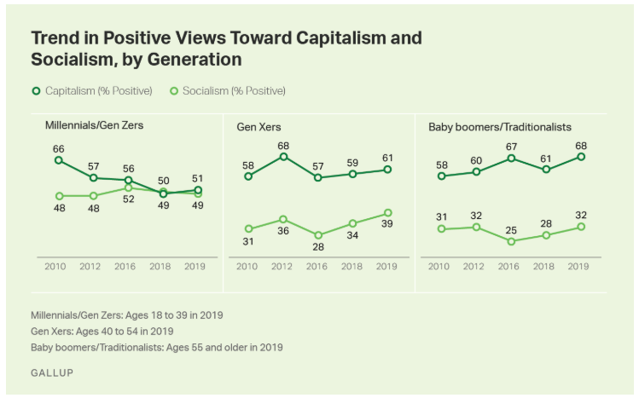
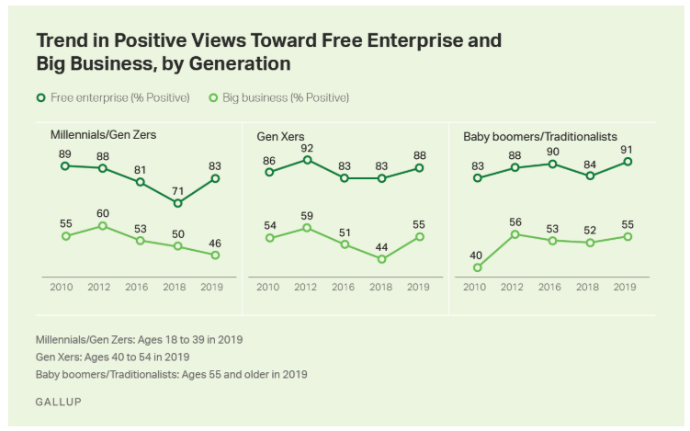
Socialism: It’s Future in America More Recent Polling (2019)
Millennials/Gen Zers (18 – 39 years old in 2019) are more receptive to socialism than older generations (40+ years old in 2019).
Still, Millennials/Gen Zers support “free enterprise” at high %’s, and free enterprise is a value of a capitalist system
Notes:
https://news.gallup.com/poll/268766/socialism-popular-capitalism-among-young-adults.aspx
Rasmussen conducted a more recent poll on April 09, 2009
Only 53% of American adults believe capitalism is better than socialism; 20% disagree and say socialism is better. Twenty-seven percent (27%) are not sure which is better.
Adults under 30 are essentially evenly divided: 37% prefer capitalism, 33% socialism, and 30% are undecided.
Thirty-somethings are a bit more supportive of the free-enterprise approach with 49% for capitalism and 26% for socialism.
Adults over 40 strongly favor capitalism, and just 13% of those older Americans believe socialism is better.
Investors by a 5-to-1 margin choose capitalism. As for those who do not invest, 40% say capitalism is better while 25% prefer socialism.
There is a partisan gap as well. Republicans - by an 11-to-1 margin - favor capitalism.
Democrats are much more closely divided: Just 39% say capitalism is better while 30% prefer socialism.
As for those not affiliated with either major political party, 48% say capitalism is best, and 21% opt for socialism.

